Slide 1


ML 24/25 Implement the visualization of permanence value
Submitted by:
Md Mushfiqul Islam 1438422
Proloy Sen 1517624
Rezoyana Islam Bonna 1502329
Master of Engineering Information Technology

Slide 2
Overview
Objective
INTRODUCTION
Methodology
Reconstruction Method in NeocortexAPI
Graphical representation of Draw Heatmap Function
Visualization Technique
Visualization Result
Validation of Result
Similarity for Image Inputs
Conclusion

Slide 3
Objective
Develop an improved visualization approach for tracking permanence value dynamics in the HTM Spatial Pooler.
Enhance interpretability and optimization of HTM models.
Use Neocortex API’s Reconstruct method to track permanence changes over time.
Apply advanced visualization techniques to represent permanence distributions.
Extend the approach to image data for evaluating its role in visual pattern recognition & reconstruction.
Provide better insights into learning dynamics and synaptic stability in HTM networks.

Slide 4
INTRODUCTION
Hierarchical Temporal Memory (HTM) is inspired by the human neocortex and specializes in recognizing temporal patterns using Sparse Distributed Representations (SDRs).
The Spatial Pooler (SP) converts raw input data into SDRs, mimicking the brain’s encoding mechanism for efficient pattern recognition & storage.
Our research focuses on the Spatial Pooler and Neocortex API’s Reconstruct() function, analyzing their role in accurate input reconstruction and permanence evolution visualization.
Permanence values determine synaptic stability and evolve with learning—visualizing them enhances our understanding of the HTM model
We explore two permanence representations: 1.Numerical inputs 2. Image data inputs
These visualizations provide deeper insights into learning dynamics and encoded representations in HTM.

Slide 5
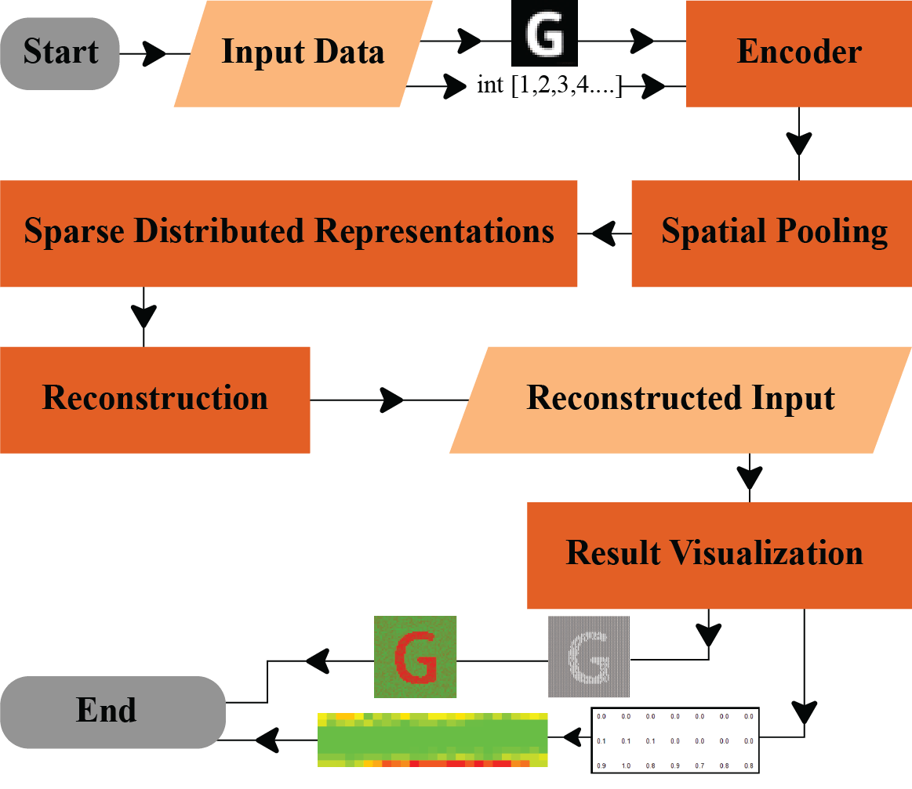
Methodology
Input Data → Encoded into a binarized form.
Spatial Pooling → Creates SDRs by detecting patterns.
Reconstruction → Converts SDRs back to approximate input.
Result Visualization → Displays the reconstructed data.

Slide 6
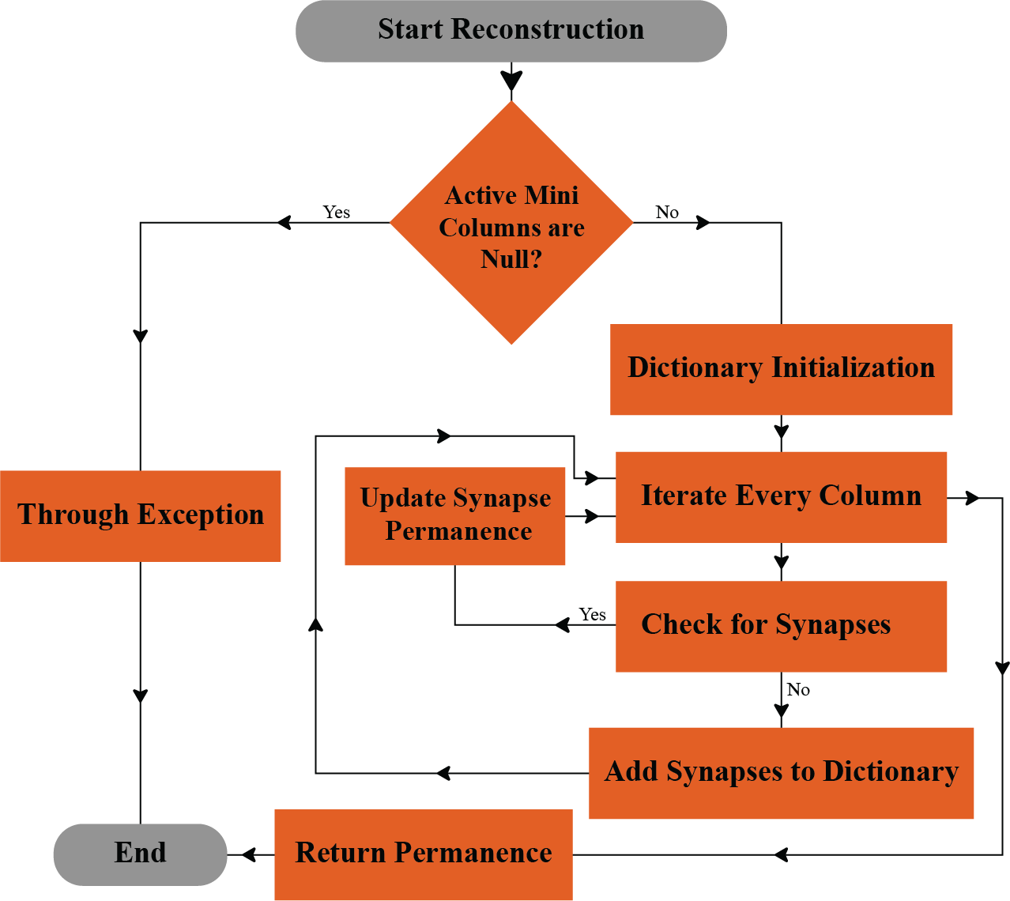
Reconstruction Method in Neocortex API
1. Start Reconstruction → Check if active mini-columns are null.
If Yes → Throw exception and end.
If No → Initialize dictionary and iterate columns.
2. Check for Synapses:
Found → Update permanence.
Not found → Add to dictionary.
3. Update Synapse Permanence → Adjust and loop if needed.
4. Return Permanence → End process.

Slide 7
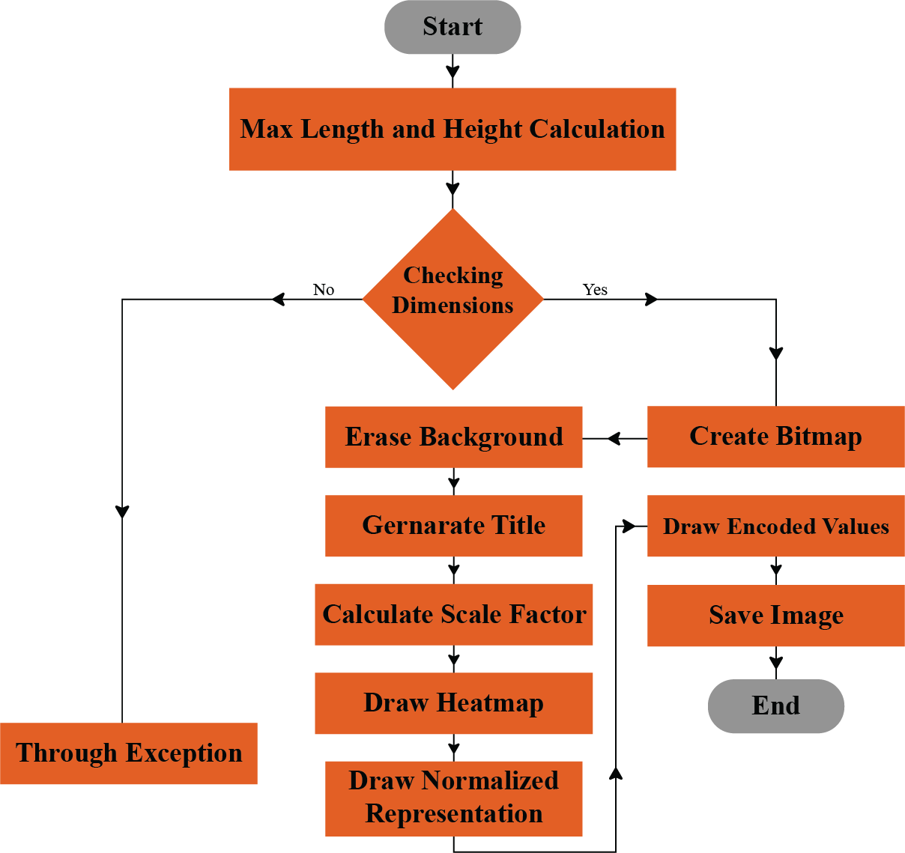
Draw Heatmap Function
Start: Process begins.
Max Length & Height Calculation: Determines size constraints.
Checking Dimensions (Decision Point):
Yes → Create Bitmap → Erase Background.
No → Trigger exception handling.
Exception Handling: If dimensions are invalid, exit process.
Generate Title → Add labels/titles.
Calculate Scale Factor → Adjust size.
Draw Heatmap → Visualize data.
Draw Normalized Representation → Final processing.
Draw Encoded Values → Add encoded data.
Save Image → Store final output.
End.

Slide 8
Visualization Technique
Encoded Input Comparison
Compares the original input with the reconstructed input.
Assesses how accurately the HTM model retains key information.
Similarity Analysis
Measures the correlation between input and reconstructed output.
Evaluates pattern recognition efficiency and learning accuracy.

Slide 9
Visualization Techniques
Normalization with Threshold
Adjusts permanence values to a defined threshold for better interpretability.
Highlights significant changes in synaptic permanence over time.
Heatmap Representation
Visualizes permanence values across different data points.
Helps identify patterns and synaptic stability in the Spatial Pooler.

Slide 10
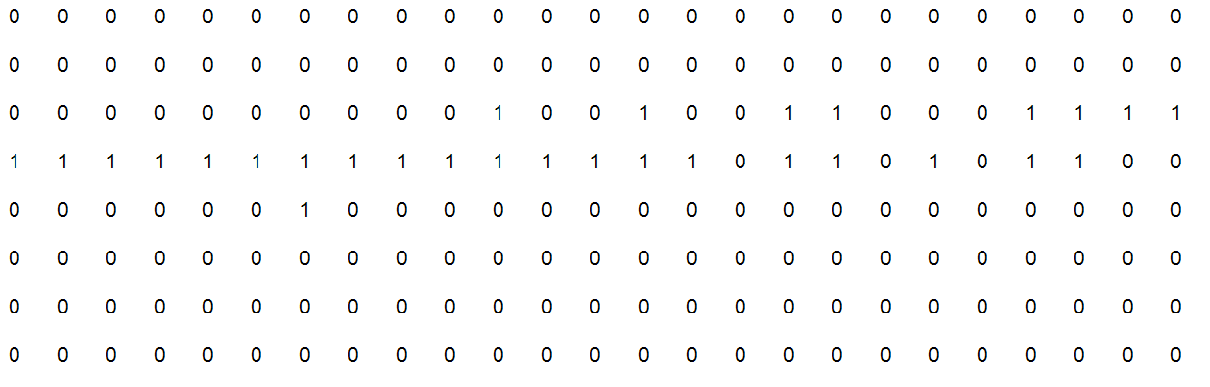
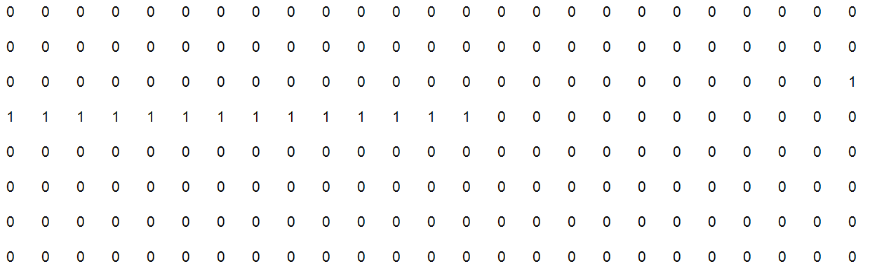
Comparing Original input and Reconstructed matrics
Encoded Input Matrics
Reconstruced Input Matrics

Slide 11

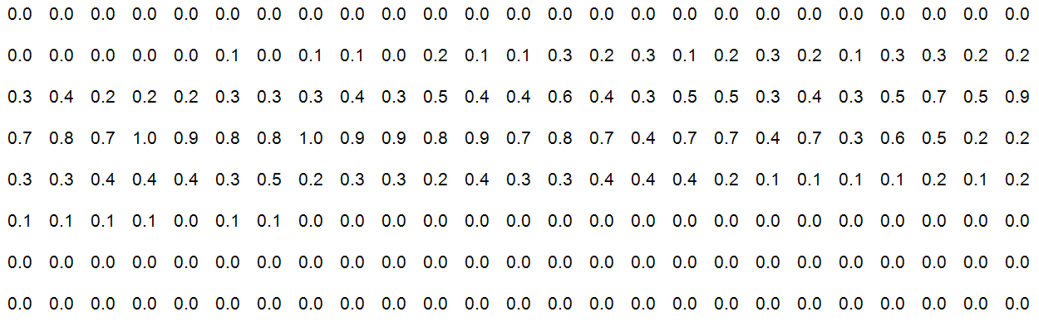
Result Visualization
For Numerical Input
Heatmap
Matrics

Slide 12

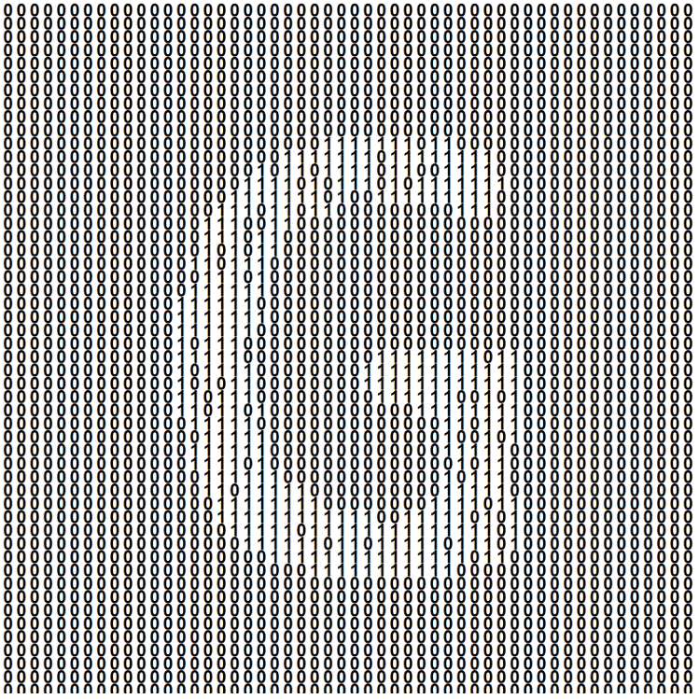
Result Visualization
For Image Input
Heatmap
Matrics

Slide 13
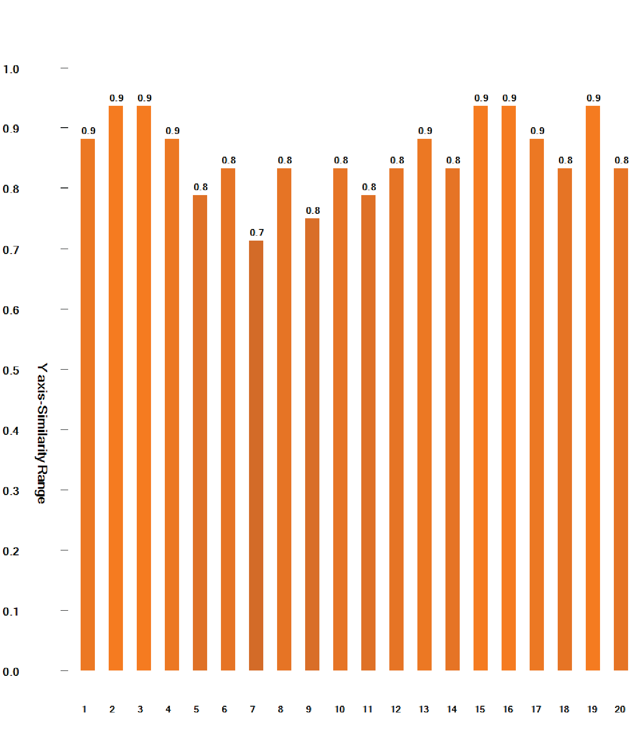
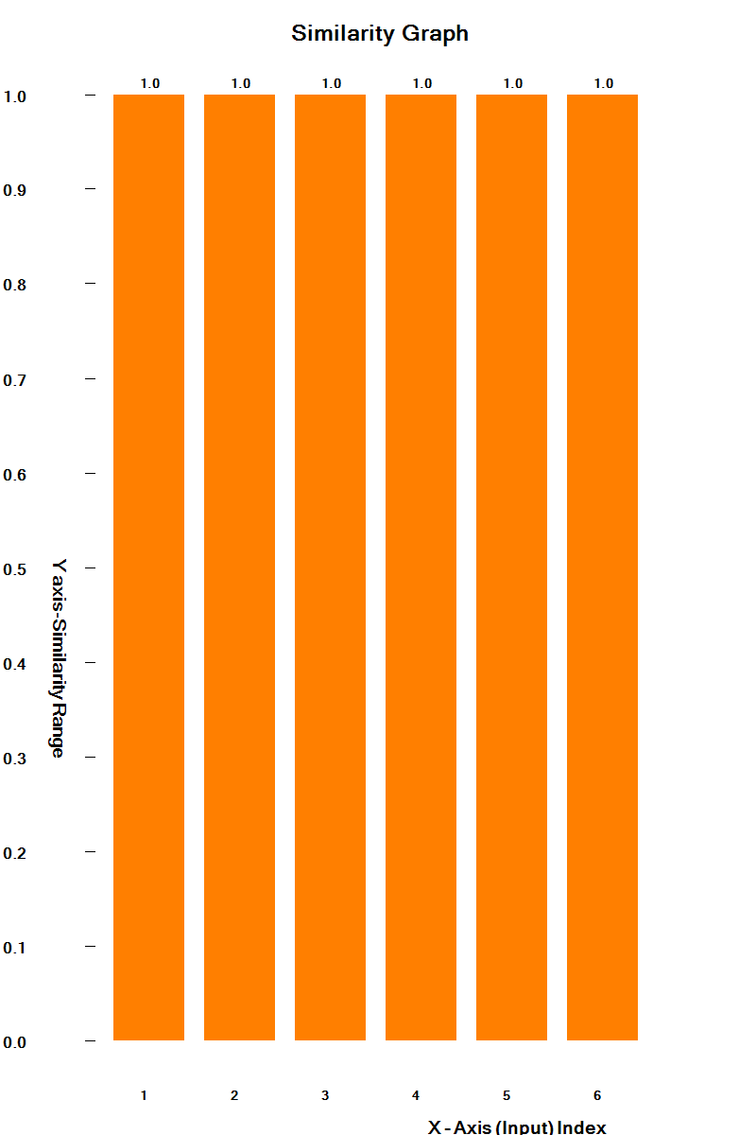
Similarity Graph
The similarity graphs of numerical Inputs
Similarity Graph for the Image Input

Slide 14
Conclusion
Visualization and Analysis
Successfully implemented HTM-based reconstruction and visualization.
Used heatmaps and matrices to analyze permanence value distribution.
Similarity graphs provided quantitative insights into reconstruction accuracy.
Impact and Future Scope
Effective for both numerical and image-based inputs.
Enhances interpretability of HTM learning dynamics.
Establishes a foundation for future improvements in HTM-based models.

Slide 15

THANK YOU

